Slide 1
Florida’s Natural May ‘25 Snapshot
May 5th, 2025

Slide 2
YTD Snapshot
01
April Snapshot
02
April Line-Item Insights
03
April Keyword Insights
04
April Category Insights
05
Pacing Report
06

Slide 3
Florida's Natural: YTD ’25 SNAPSHOT
Criteo sponsored products
Campaign Dates: November 18th, 2025 – October 31st, 2025
Snapshot Dates: January 1st, 2025 - April 30th, 2025
Overview
Total Budget | Optimizer
$219,000 | Revenue (ROAS)
Campaign
Details
25,583,739
101,475
$76,636
$207,349
62,573
$0.76
$2.71
Impressions
Clicks
Spend
Revenue
Units Sold
CPC
ROAS
Florida's Natural drove $207,349 in revenue on $76,636 in spend so far in 2025.
Avg cap out Hour: 10:00 AM EST

Slide 4
Florida's Natural: APRIL ’25 SNAPSHOT
Criteo sponsored products
Campaign Dates: November 18th, 2025 – October 31st, 2025
Snapshot Dates: April 1st, 2025 - April 30th, 2025
Overview
Total Budget | Optimizer
$219,000 | Revenue (ROAS)
Campaign
Details
6,984,627
24,296
$18,906
$51,435
16,809
$0.78
$2.72
Impressions
Clicks
Spend
Revenue
Units Sold
CPC
ROAS
Florida's Natural drove $51,435 in revenue on $18,906 in spend in April.
Avg cap out Hour: 9:00 AM EST

Slide 5
Florida's Natural: APRIL ’25 LINE ITEMS
Criteo sponsored products
Line-Item | Impressions | Clicks | Spend | Sales | Units | Avg. CPC | ROAS | Capout Hour
Lemonade | 6,879,066 | 23,925 | $18,598 | $49,719 | 16,535 | $0.78 | $2.67 | 4:00 PM EST
Orange Juice | 105,561 | 371 | $308 | $1,716 | 274 | $0.83 | $5.57 | 2:00 AM EST
Key Takeaways
The Lemonade line-item is still receiving the largest portion of the budget and seeing strong results, beating category averages.
The OJ line-item is still capping out very early. With small spend, there is not much we can do to extend here.
Regardless, OJ is showing great results!

Slide 6
Florida's Natural: APRIL ’25 KEYWORDS
Criteo sponsored products
Keyword | Impressions | Spend | Sales | ROAS
juice | 150,332 | $4,292 | $11,242 | $2.62
juice orange | 187,833 | $2,730 | $5,366 | $1.97
lemonade | 73,337 | $2,613 | $7,569 | $2.90
florida natural | 9,550 | $192 | $646 | $3.36
lemonade strawberry | 2,593 | $185 | $601 | $3.25
lemonade sugar zero | 1,538 | $122 | $375 | $3.08
free lemonade sugar | 963 | $83 | $281 | $3.38
free juice sugar | 1,556 | $76 | $253 | $3.33
florida juice natural orange | 7,077 | $66 | $104 | $1.58
fruit juice passion | 380 | $61 | $153 | $2.51
juice sugar zero | 1,003 | $50 | $142 | $2.83
fruit passion | 1,172 | $46 | $103 | $2.21
lemonaid | 588 | $38 | $86 | $2.24
fruit juice | 1,082 | $35 | $111 | $3.10
florida lemonade natural | 548 | $23 | $119 | $4.99
Note:
This is only inclusive of search placements, which is not 100% of spend. SPA also delivers on category, checkout, PDP, and home pages, which require no keywords

Slide 7
Florida's Natural: APRIL ’25 CATEGORIES
Criteo sponsored products
Category | Impressions | Spend | Sales | ROAS | ROAS Benchmark
lemonade & limeade | 4,773,395 | $12,327 | $35,588 | $2.89 | $2.37
berry & blends | 1,867,083 | $5,453 | $11,995 | $2.20 | $1.77
fruit punch | 238,588 | $817 | $2,136 | $2.61 | $2.67
orange juice | 102,879 | $284 | $1,618 | $5.70 | $2.86
grapefruit juice | 2,682 | $24 | $97 | $4.06 | $3.09
Key Takeaways
We are beating category averages on almost all 4 categories! Fruit Punch only behind by 6 cents.
OJ is ahead of category averages by nearly double.

Slide 8
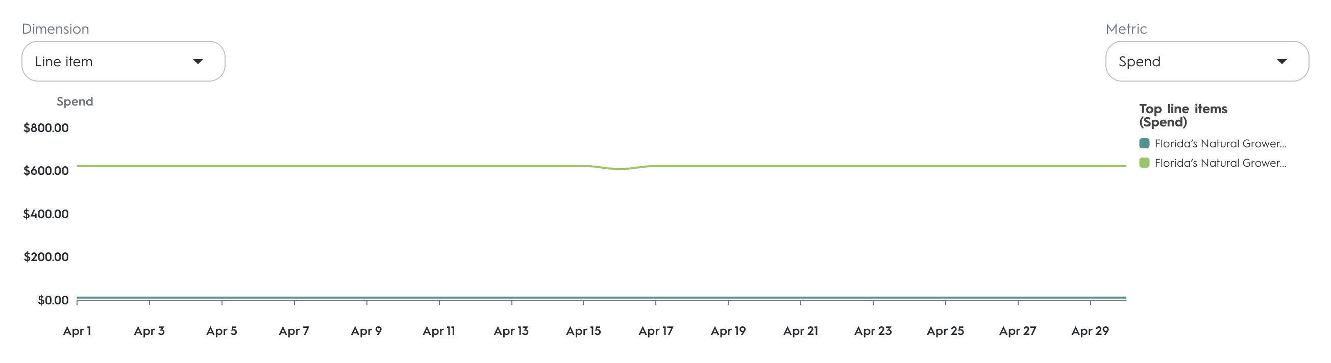
Florida’s Natural: PACING REPORT
Criteo sponsored products
Strategy
Campaign | % Of Flight Date | % Of Budget Spent | Pacing Relative To Budget
Orange Juice | 46% | 93% | 47%
Lemonade | 46% | 40% | -7%
Key Takeaways
Both campaigns are pacing to deliver in full!

Slide 9
Contact me with questions!
Jackson Ensley
j.ensley@criteo.comin CPCs (~$0.30), resulting in a drop in ROAS.

